Slide 1

Geometry
Unit 12, Lesson 5 Pythagorean Theorem and Tangent Lines Volume 2, pg. 251

Slide 2


Benchmark
MA.912.GR.6.1
Solve mathematical and real-world problems involving the length of a secant, tangent, segment, or chord in a given circle.
volume 2, pg. 251

Slide 3
Integrated Mathematical Thinking and Reasoning Standards
MA.K12.MTR.1.1 Actively participate in effortful learning both individually and collectively.
MA.K12.MTR.4.1 Engage in discussions that reflect on the mathematical thinking of self and others.
MA.K12.MTR.5.1 Use patterns and structure to help understand and connect mathematical concepts.
MA.K12.MTR.6.1 Assess the reasonableness of solutions.
volume 2, pg. 251

Slide 4

Learning Target
I can use the Pythagorean Theorem to solve mathematical and real-world problems involving the length of a tangent segment to a circle.
volume 2, pg. 251

Slide 5

Warm-Up
volume 2, pg. 252

Slide 6
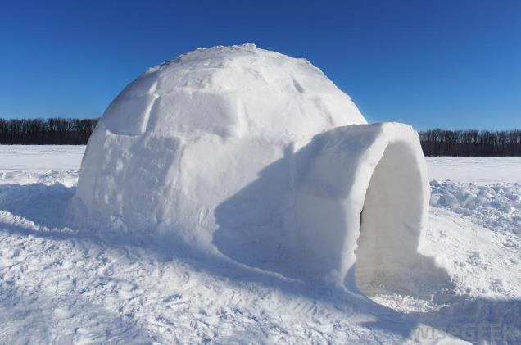
12.5.1 Warm-Up: Ice Problem
An igloo, also known as a snow house or snow hut, is a type of shelter built out of snow.
What is the first question that comes to your mind?
Write a question that would require someone to use geometry to solve.
volume 2, pg. 252

Slide 7

Exploration
volume 2, pg. 252

Slide 8

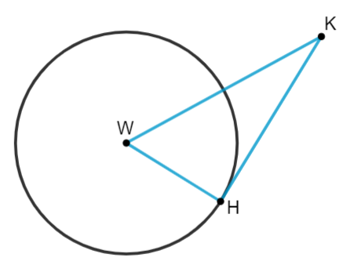
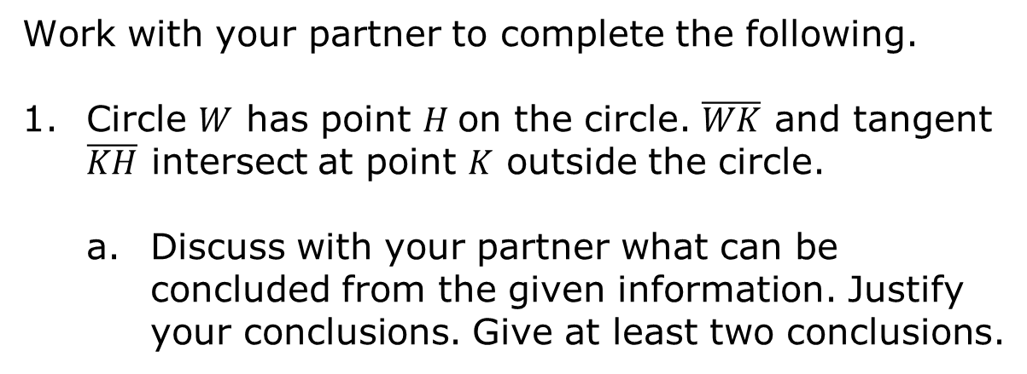
12.5.2 Exploration: Pythagorean Theorem and Tangent Lines
Work with your partner to complete the following.
Circle $W$ has point $H$on the circle. $\overline{WK}$ and tangent $\overline{KH}$ intersect at point $K$ outside the circle.
Discuss with your partner what can be concluded from the given information. Justify your conclusions. Give at least two conclusions.
volume 2, pg. 252

Slide 9
Ask a classmate for two conclusions they drew. Record their conclusions and write your summary of their reason. You are the only person who should write in the first two columns of the table. Have the person initial next to your summary stating that your summary was correct.
Conclusion | My Summary of Their Reason | Initials
volume 2, pg. 253

Slide 10
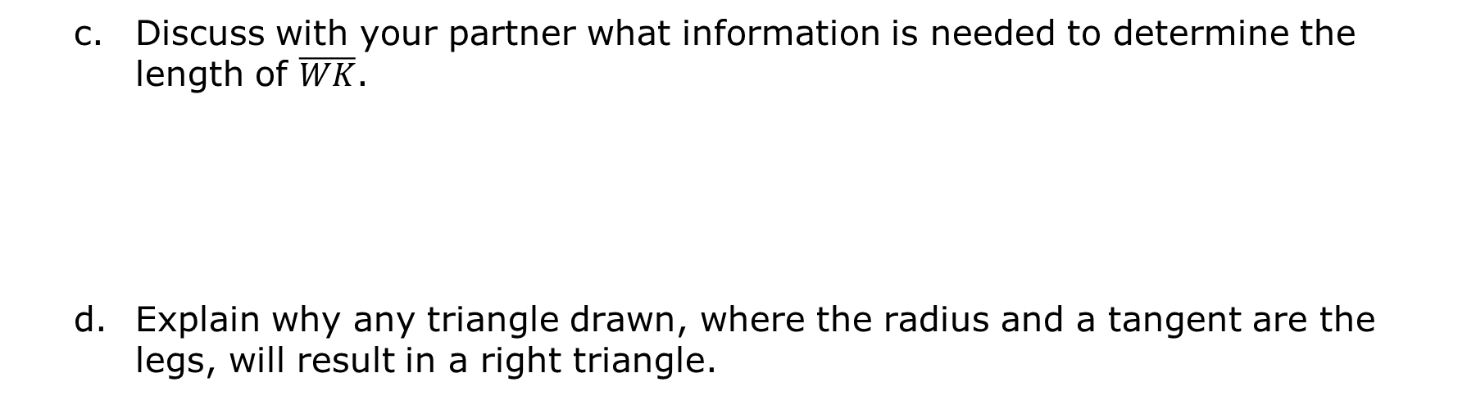
Discuss with your partner what information is needed to determine the length of $\overline{WK}$.
Explain why any triangle drawn, where the radius and a tangent are the legs, will result in a right triangle.
volume 2, pg. 253

Slide 11
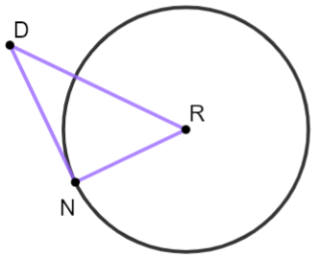
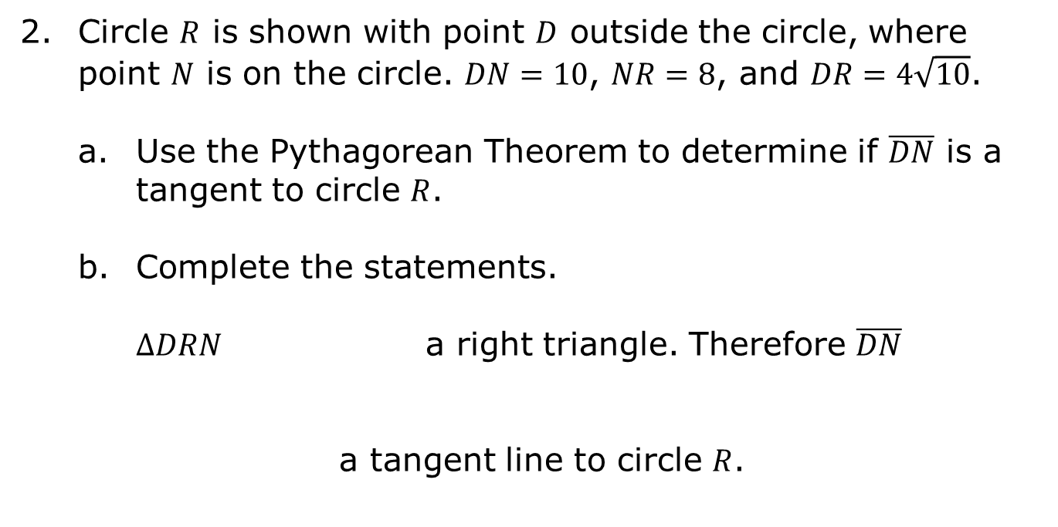
Circle $R$ is shown with point $D$ outside the circle, where point $N$ is on the circle. $DN=10$, $NR=8$, and $DR=4\sqrt{10}$.
Use the Pythagorean Theorem to determine if $\overline{DN}$ is a tangent to circle $R$.
Complete the statements. $∆DRN$ a right triangle. Therefore $\overline{DN}$
a tangent line to circle $R$.
is
is not
is
is not
volume 2, pg. 253

Slide 12

Guided Practice
volume 2, pg. 254

Slide 13

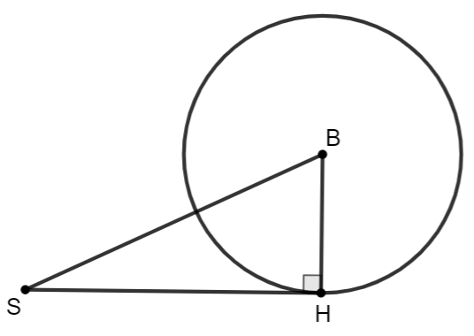
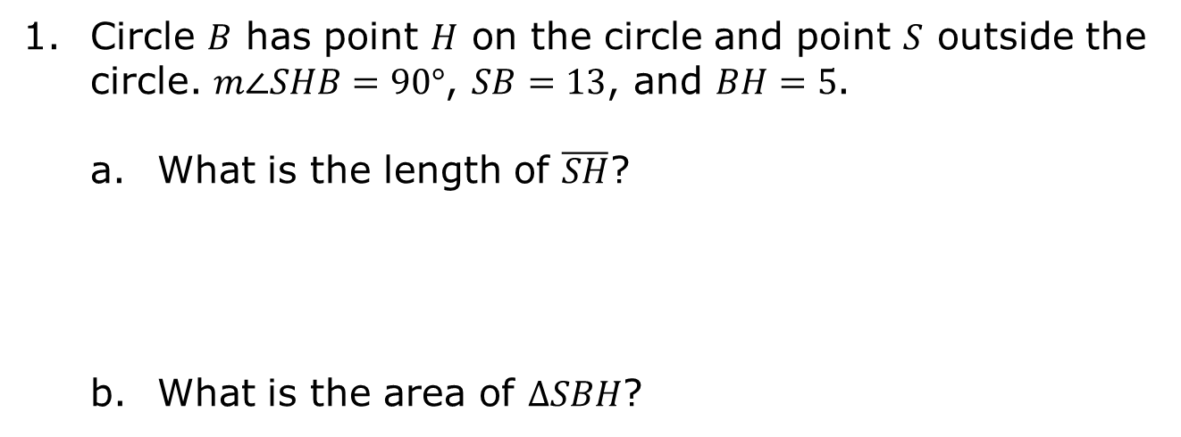
12.5.3 Guided Practice: Pythagorean Theorem and Tangent Lines
Circle $B$ has point $H$ on the circle and point $S$ outside the circle. $m∠SHB=90°$, $SB=13$, and $BH=5$.
What is the length of $\overline{SH}$?
What is the area of $∆SBH$?
volume 2, pg. 254

Slide 14
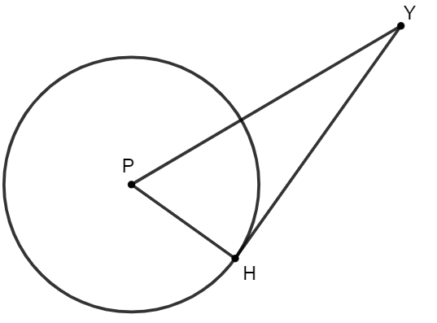
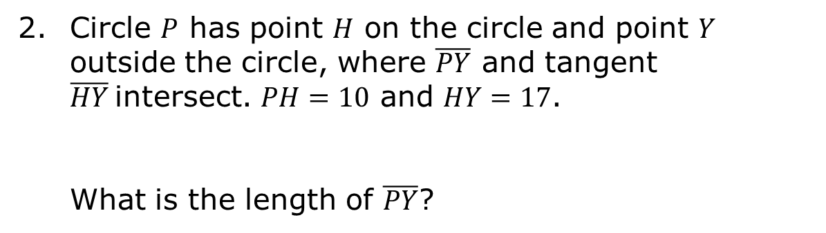
Circle $P$ has point $H$ on the circle and point $Y$ outside the circle, where $\overline{PY}$ and tangent $\overline{HY}$intersect. $PH=10$ and $HY=17$.
What is the length of $\overline{PY}$?
volume 2, pg. 254

Slide 15
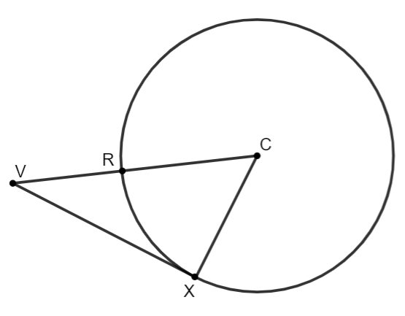
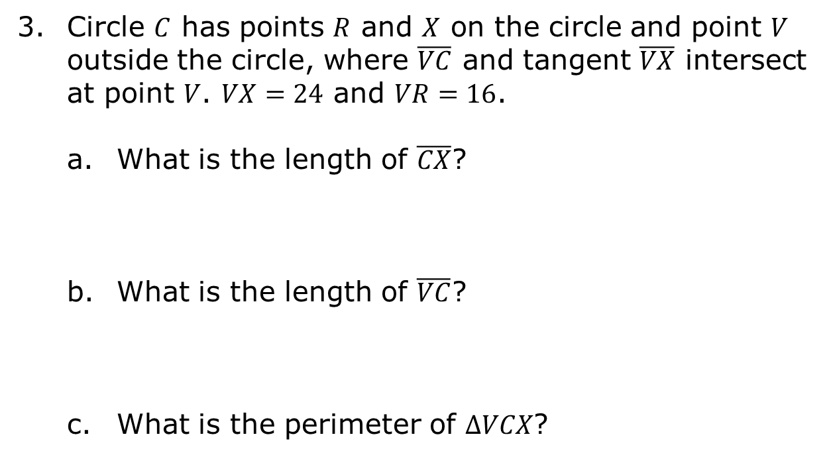
Circle $C$ has points $R$ and $X$ on the circle and point $V$ outside the circle, where $\overline{VC}$ and tangent $\overline{VX}$ intersect at point $V$. $VX=24$ and $VR=16$.
What is the length of $\overline{CX}$?
What is the length of $\overline{VC}$?
What is the perimeter of $∆VCX$?
volume 2, pg. 255

Slide 16

Your Turn
volume 2, pg. 255

Slide 17
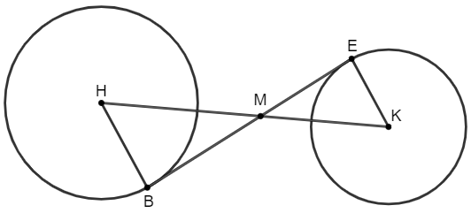
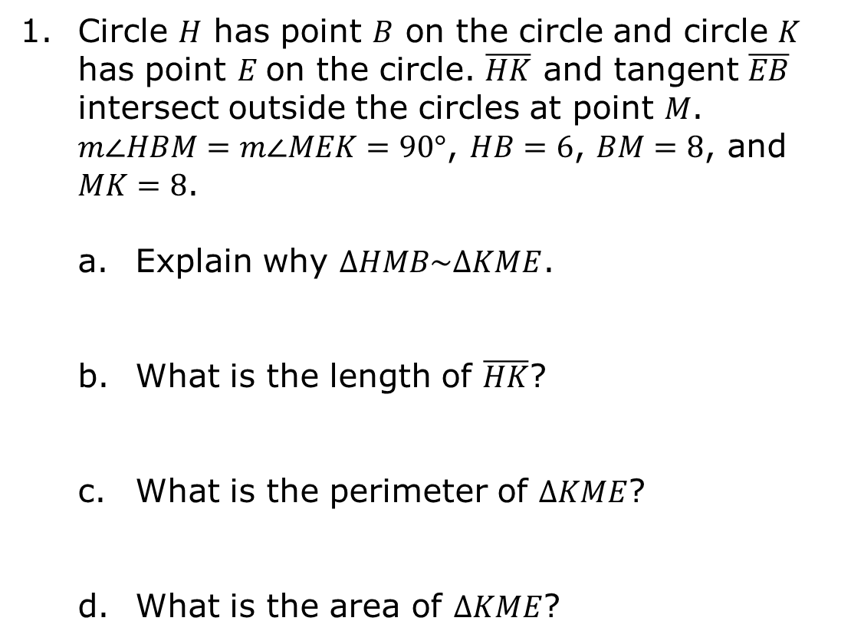
12.5.4 Your Turn!
Circle $H$ has point $B$ on the circle and circle $K$ has point $E$on the circle. $\overline{HK}$ and tangent $\overline{EB}$ intersect outside the circles at point $M$. $m∠HBM=m∠MEK=90°$, $HB=6$, $BM=8$, and $MK=8$.
Explain why $∆HMB\sim ∆KME$.
What is the length of $\overline{HK}$?
What is the perimeter of $∆KME$?
What is the area of $∆KME$?
volume 2, pg. 255

Slide 18
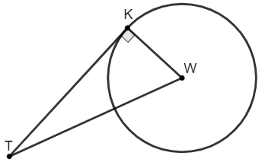
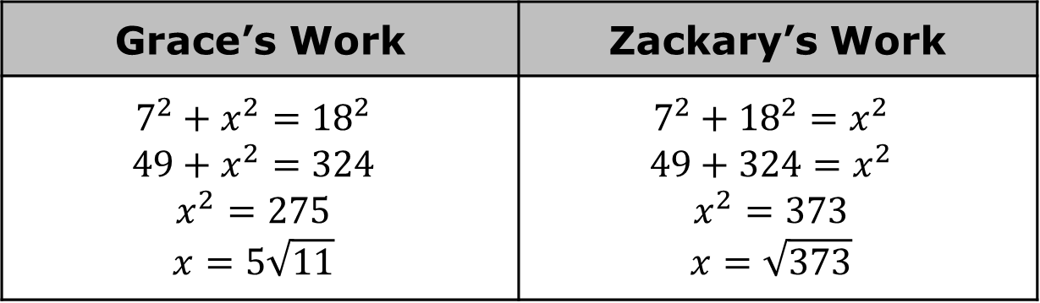
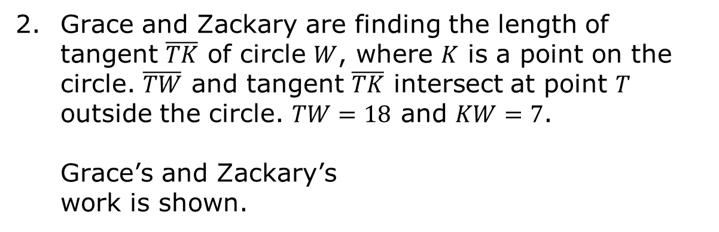
Grace and Zackary are finding the length of tangent $\overline{TK}$ of circle $W$, where $K$ is a point on the circle. $\overline{TW}$ and tangent $\overline{TK}$ intersect at point $T$ outside the circle. $TW=18$ and $KW=7$.
Grace’s and Zackary’s work is shown.
Grace’s Work | Zackary’s Work
$$7^{2}+x^{2}={18}^{2}$$ $$49+x^{2}=324$$ $$x^{2}=275$$ $$x=5\sqrt{11}$$ | $$7^{2}+{18}^{2}=x^{2}$$ $$49+324=x^{2}$$ $$x^{2}=373$$ $$x=\sqrt{373}$$
volume 2, pg. 256

Slide 19
Write a note to the person whose work is incorrect explaining their mistake.
Means
I
Start
To
Acquire
Knowledge
Experience
Skills
volume 2, pg. 256

Slide 20

Wrap-Up
volume 2, pg. 256

Slide 21
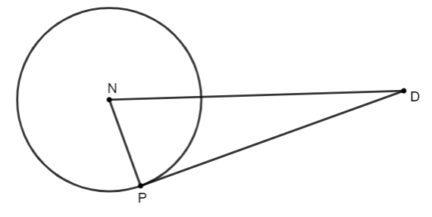

12.5.5 Wrap-Up: Ticket Out the Door
Circle $N$ has point $P$ on the circle and point $D$ outside the circle at the intersection of $\overline{DN}$ and tangent $\overline{DP}$. $NP=2$ and $DP=6$.
What is the length of $\overline{ND}$?
volume 2, pg. 256

